Slide 1
Composite SOFTWARE Data Abstraction Best Practices Technical Guide
Mike Tinius
April, 2013

Slide 2
Agenda
Data Abstraction Conceptual Design
Implementing Data Abstraction Design Concepts in Composite
Summary of Key Benefits
Practical Next Steps

Slide 3




Data Abstraction Goals Achieve Reusability, Maintainability, and Performance
Customer Challenges
Want to build a virtualized abstraction layer for applications to access instead of accessing the physical sources
Developers code similar logic many times, so partitioning is desired
Layered approach is better, but layers can have performance overhead
Composite Solution
Decoupling and reuse sources via layered data virtualization implementation
Optimize away middle layers at runtime for better performance
Business Impact
Right information, when needed
More aligned business and IT model for better agility, efficiency, reuse
Business and IT change insulation
Better data security and control
Cost Savings
Sales Growth
Risk Reduction
Complexity
Structure
Data Abstraction
Location
Completeness
Latency
Notes:
The “Architectural Concepts” outlined in this diagram speak to 4 layers of views. Each view will be described in more detail in subsequent slides.
The main theme to understand here is that the “Canonical Views” are the key to the abstraction layer. An abstraction layer in general is put in place so that applications may access this central data authority instead of going directly to the data sources themselves. Composite Information Server provides the mechanisms to publish Data Services through Web Services or JDBC sources.
There are many good reasons to have a data abstraction layer such as the following:
Right information at the right time – Fulfill business’s complete information needs on demand by linking multiple, diverse data sources together for delivery in real-time.
Business and IT model alignment – Gain agility, efficiency, and reuse across applications via an enterprise information model or logical business model. Often times, known as the “Canonical” model, this abstracted approach overcomes data complexity, structure, and location issues.
Business and IT change insulation – Insulate consuming applications from changes in the source and vice versa. Developers create their applications based on a more stable view of the data. Allow ongoing changes and relocation of physical data sources without impacting consumers.
End-to-end control – Use a single platform to design, develop, manage and monitor data access and delivery processes across multiple sources and consumers.
More secure data– Consistently apply data security rules across all data sources and consumers via a unified security methods and controls.

Slide 4

Data Abstraction Reference Architecture Layered Architecture View
ESB/ BPM
Data Consumers
BI Server
App Server
Application Layer
Consumer
Customer
Order
Buyer
Order
Customer
Order
Business Layer
Physical Layer
customers
purchase
orders
orders
orderdetails
products
Data Sources
Customers DB
Purchasing DB
Orders DB
Product
Catalog
Notes:
Data Consumers – Client applications want to retrieve data in various formats and protocols. They want to receive the data in a way that they understand. Composite allows the consumers to format the data according to their specifications and deliver over various transport protocols including: Web Services, REST, JDBC and Java clients.
Application Layer – The “Application Layer” serves to map the Business Layer into the format which each Data Consumer wants to see their data. It might mean formatting into XML for Web services or creating views with different alias names that match the way the consumers are used to seeing their data.
Business Layer – The “Business Layer” is predicated on the idea that the business has a standard or canonical way to describing key business entities such as customers and products. In the financial industry, one often accesses information according to financial instruments and issuers amongst many other entities. Typically, a data modeler would work with business experts and data providers to define a set of “logical” or “canonical” views that represent these business entities. These views are reusable components that can and should be used across business lines by multiple consumers.
Physical Layer – The Physical Layer provides two valuable capabilities for introspecting and mapping to the Business Layer.
The physical “Metadata” sub-layer is essentially imported from the physical data sources and used as way to onboard the metadata required by the data abstraction layer to perform its mapping functions. As an “as-is” layer, entity names and attributes are never changed in this layer.
Ultimately, physical data sources have to be integrated into this virtualization layer. This is done in the “Formatting” sub-layer along with simple tasks such as name aliasing, value formatting, data type casting, derived columns and light data quality mapping. In general this layer is derived from the physical sources and performs a one-to-one mapping between the physical source attributes and their corresponding “logical/canonical” attribute name. Naming conventions are very important and introduced in this layer.
Data Sources –The data sources are the physical information assets that exist within and without an organization. These assets may be databases, packaged applications such as SAP, Web services, Excel spreadsheets and more.

Slide 5
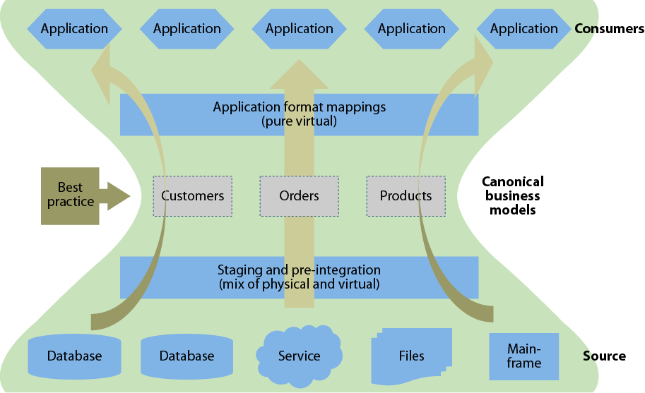
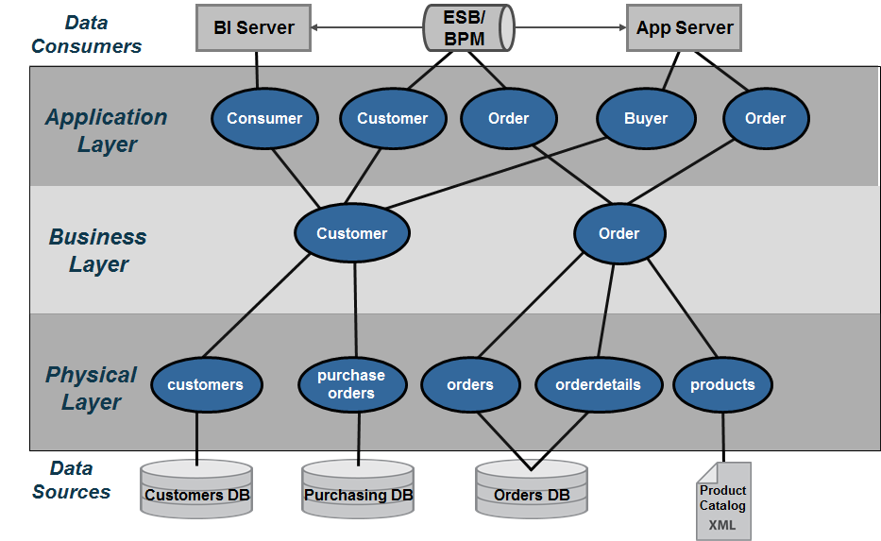
How Composite Implements Forrester’s Data Virtualization Vision
Notes:
According to Forrester “Leading firms have implemented a layered architecture combining both physical and virtual data stores, choosing the appropriate mix based on different areas’ performance requirements. In the most-successful cases, the firms create an hourglass-shaped architecture that funnels mappings of disparate source data through canonical business information models. As a result, one large drug manufacturer is able to successfully operate with both IBM Cognos and SAP Business Objects BI tools for different customer groups, using data that has been reconciled against common metadata using virtualization.
In addition to the use of canonical models in the middle, we have identified two other noteworthy characteristics of this architecture: 1) virtual/physical modality choices tend to be more physical in the staging layers close to the actual data sources and more virtual as data moves closer to the users, and 2) a final virtual mapping layer ensures that the solution provides data to consumers in just the required format.”

Slide 6
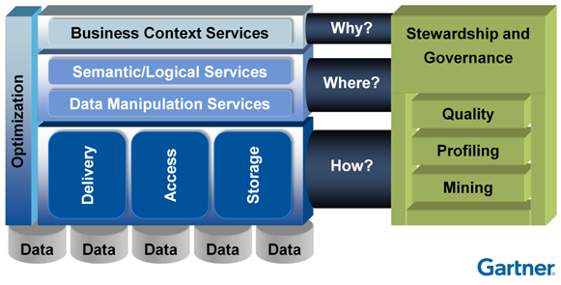
Gartner’s Discipline of Data Integration
Data integration enables data structures that were designed independently to be leveraged together.
Practices
Architectural Techniques
Tools
Advancing Your Data Integration Competency in Support of Analytics
Ted Friedman, Business Intelligence Summit
Gaylord Texan Hotel & Convention Center Grapevine, Texas
©Gartner Research, Inc.
Notes:
Composite’s data abstraction reference architecture can be used to implement Gartner’s “Discipline of Data Integration” as follows:
Practices – Composite has shaped the best practices that customers use today to implement data virtualization in their organizations. Composite also has influenced the practices of recommended by leading IT analysts and system integrators. This thought-leadership and real-world experience helps users gain confidence when deploying data virtualization in their organization.
Architectural Techniques – Composite Professional Services brings a wealth of knowledge and skills to help users architect their data virtualization solutions. Composite’s architectural techniques are including in Composite Professional Services’ Quick Start program. This program is designed to help customers get a project up and running quickly and maximize their return. During this program, customers are introduced to the “Data Abstraction Best Practices Technical Guide” that Professional Services Consultants use an architectural techniques blueprint.
Tools – The Composite Data Virtualization Platform provides a complete and proven tool to implement Gartner’s “Discipline of Data Integration”.
Business Context Services – In Composite’s reference architecture the Application Layer provides the mechanisms for mapping and publishing views or web services in the context of the applications. Composite’s Application Layer maps into Gartner’s Business Context Services. Application consumers require delivery of data via different protocols. Within Composite’s reference model, data consumers use a variety of standard protocols including JDBC, ODBC, SOAP/HTTP, REST and ADO/.Net to access needed data. These standard protocols support the BI, MDM, Web service API’s and Enterprise Objects consumer’s included by Gartner.
Semantic/Logical Services – Gartner’s “Semantic/Logical” services provide for the transformation of the physical model into the business context view of the information. The term logical and semantic are often referred to as canonical. It is a way of defining a common data dictionary across the business. The terms or attributes from this data dictionary are grouped together into semantically similar entities. Composite supports these needs with its formatting views.
Data Manipulation Services – Gartner’s “Manipulation” functions include Access, Storage, and Delivery which align with Composite’s physical layer. This is where Composite’s introspection, discovery, and source data access tools expose the physical layer. Increasingly, Composite is providing access to a wide array of data sources including relational, service oriented, file, packaged applications and big data.
Optimization – Both Gartner and Composite view optimization as spanning the entire architecture from source to consumer, both during design and runtime, perfectly matching how Composite’s optimizers work.

Slide 7
User Roles and Responsibilities
Application Developers
Composite
Developers
Enterprise
Data
Modelers
Data Governance Team
Database Administrators &
Data Modelers
Notes:
The following roles and responsibilities should be considered when implementing a data abstraction layer:
Application Developers – Application developers are concerned with the API’s and the various mechanisms by which they can access the data from the data abstraction layer. Often times, data lineage is important to the client-side developers because they need to know the originating source. Composite can provide data lineage from the client services views down to the physical metadata.
Enterprise Data Modelers and Data Architects – Enterprise data modelers and data architects work with subject mater experts who know the business and use their expertise to craft logical data models. These logical data models can be further refined into something that is closer to a logical database design which could be used as the basis for building views in the business layer. Enterprise data modelers work with Composite developers to design effective views and services.
Composite Developers – Composite developers are responsible for the implementation of the layers using the Composite data virtualization middleware. This implementation is based on the overall architecture and concepts laid forth in this document and performed in conjunction with the other teams involved. They need to understand the application developer requirements so they can construct the API layers and views above the business layer as well as the underlying sources. Beyond lineage tools and folders available within Composite, these developers often use additional control systems to understand and manage key mappings across the various layers.
Database Administrators (DBAs) and Database Modelers – DBAs and database modelers provide access to the physical data sources. Further they help define logical database designs from their corresponding physical database designs and implementations. They work with Composite developers to ensure are properly tuned and assist with creating indexes if necessary.
Data Governance Teams – Data governance staff are involved throughout the process making sure that enterprise data access and data mapping rules are followed. Further, they provide guidance on how data should be modeled and often help to resolve data quality issues.

Slide 8
Data Abstraction “Technical” Design Sub-Layered Architecture View
ESB/ BPM
Data Consumers
BI Server
App Server
JDBC
Web Services
JDBC
REST
Customer
Order
Published
Application Layer
getCustomerByID(id)
getOrderByID(id)
getOpenOrder()
Services
Customer
Customer
Order
Buyer
Order
Views
DefinitionSets
Active Customer
Open Orders
Business
Business Layer
Customer
Order
Order1
Order2
Logical
Customers
Orders
Product Catalog
DiscoveryModels
Orders
Order Details
Order Details
Physical Layer
Formatting
CUSTOMERS
ORDERS
ORDERS
ORDER DETAILS
ORDER DETAILS
PRODUCTS
Metadata
Data Sources
Customers DB
Order1 DB
Order2 DB
Product
Catalog
Notes:
Sub-Layered Architecture View
The Sub-Layered Architecture View outlines four primary layers within Composite with each layer containing one to two sub-layers. At the bottom of the diagram are the data sources or information assets within an organization. At the top are various data consumers that need access to these information assets. This section will describe the purpose of each layer.
Data Consumers – client applications want to retrieve data in various formats and through different protocols. They want to receive the data in a way that they understand. Composite allows the consumers to format the data according to their specifications and deliver over various transport protocols including: Web Services, REST, JDBC and Java.
Application Layer – this layer serves to map or conform the Business layer into the format which the Data Consumer wants to see their data. It might mean formatting into XML for web services or creating views with different alias names that match the way the consumers are used to seeing their data.
Published – Provides the contract with the consuming application. Explicitly cast views or web service implementation procedures.
Services – Procedural logic for shaping results, applying parameters, grouping, ordering, aggregation and XML shaping.
Views – client views map from the Business Layer Logical Views to the names used by the client API
DefinitionSets – Provides a central location for all Schema, WSDL and SQL definition sets.
Business Layers – this layer is predicated on the idea that the business has a standard or canonical way to describing their business. In the financial industry, one often accesses information according to financial instruments and issuers amongst many other entities. Typically, a Data Modeler would work with business experts and data providers to define a set of “logical” or “canonical” views that represent the business. These views are reusable components that can and should be used across business lines by multiple consumers.
Business– Business Layer Views that implement business rules by narrowing sets of data via where clauses or aggregating data. Perform view unions as needed within this layer and from the logical views.
Logical– Business Layer Logical views predicated on the business. Perform simple joins, federated joins, unions and federated unions.
Physical Layer – the physical layer is essentially imported from the physical data sources and used as way to onboard the metadata required by the Data Virtualization layer to perform its mapping functions.
DiscoveryModels – The Composite Discovery Models provides a place to store the introspected discovery model information. Because Composite Discovery is targeted at finding relationships in the physical data, it makes sense to store the models in the Physical Layer close to where the actual physical source metadata is located.
Formatting – Formatting views perform the mapping of physical to business logical – they are the core views of the Formatting Layer. Provides a physical abstraction of the physical metadata layer for purposes of rebinding and caching. ultimately, physical data sources have to be mapped into this virtualization layer and it is the job of the formatting layer to provide simple tasks such as name aliasing, value formatting, data type casting, derived columns and light data quality mapping. In general this layer is derived from the physical sources and performs a one-to-one mapping between the physical source attributes and their corresponding “logical/canonical” attribute name. Naming conventions are very important and introduced in this layer.
Formatting/Transformations – This sub-layer provides a place to create XSLT transformations to map XML sources to table/rowset types.
Metadata – Provide the metadata of the physical data sources which gives Composite a tangible entity for it’s views to point to. Entity names and attributes are never changed in this layer. It’s an as-is layer.

Slide 9
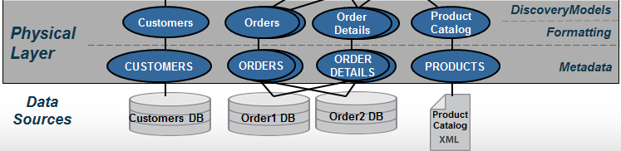
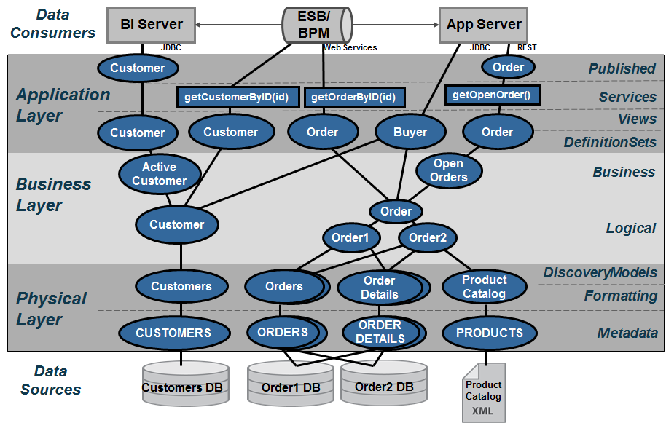
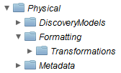
Data Abstraction Technical Design Physical Layer
Physical Layer
Composed of 3 sub-layers
Discovery Models – Contains models from Discovery output.
Formatting – Abstraction of physical sources containing the physical to business logical formatting.
Metadata – Access to physical sources.
Naming Conventions for this layer
Physical
DiscoveryModels
Formatting
Metadata
Notes:
Physical Layer
The Physical layer is composed of three sub-layers that contain the physical representation of the data sources. This physical representation or metadata structurally looks exactly like the data source; however it does not store any data. It is a virtual representation of the data source. This is the first level of data source insulation that occurs which allows operations to rebind sources from Development, UAT and Production.
Naming conventions are established at this layer so folder ordering within Composite is visually consistent with these diagrams.

Slide 10
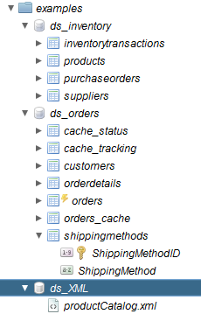
Data Abstraction Technical Design Physical Layer (Metadata)
Metadata
Composite Information Server automatically introspects data sources
Metadata representations of physical resources created during introspection
Metadata matches the physical source
Maintains cardinality statistics on sources
Introspects element metadata
Primary/Foreign keys
Indexes
Composite allows for re-introspection at this layer
Synchronization with source
Can be manual or automated
Notes:
Physical Metadata
The Physical Metadata are imported from the customer’s data sources. In Composite, the tool, “New Data Source” wizard walks the Composite Developer through a series of screens to import metadata for a source. It generates the physical metadata. There are no manual steps involved here. Physical sources can be Relational (tables, views, stored procedures, SQL Statements), Web Services, Flat Delimited Files, XML Files, Java Functions, Packaged applications such as SAP and much more. Besides capturing table and column structures, this wizard performs introspection of indexes, primary keys and foreign keys. This metadata also provides the capability to capture cardinality statistics on source tables which helps the Composite cost-based optimizer perform optimal query decisions. Composite allows for re-introspection of these sources either manually or automatically. This is important from the standpoint of a Data Abstraction Layer.

Slide 11
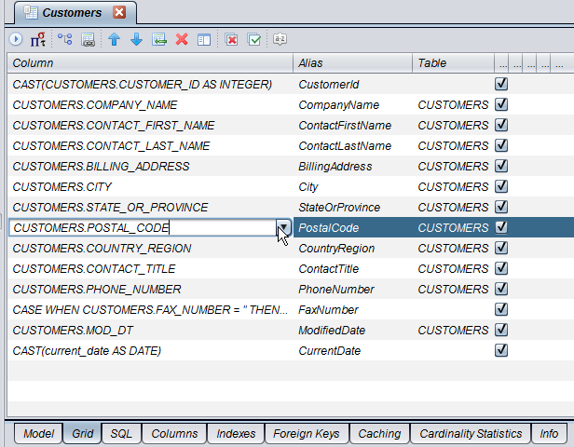
Data Abstraction Technical Design Physical Layer (Formatting)
Formatting
Transform physical to logical
Formatting / Transformation
Name aliasing
Value formatting
Data type casting
Simple derived columns
New columns
Null mapping
Light data quality
One-to-one mapping
SQL-based for easy maintainability
Caching
Rebinding
Transformation of XML
Column = Physical Name
Alias = Abstract / Canonical Name
Notes:
Formatting
The general guidelines for this layer are as follows:
• One-to-one mapping. These views provide a one-to-one correspondence between the physical and the formatting views. Generally, the names and types of data elements the physical layer are mapped to their corresponding “logical/canonical” name and type. An example of one-to-one mapping is shown below:
/project/Physical/Metadata/ORDER_SYSTEM → /project/Physical/Formatting/Orders
OID → OrderId
CID → CustomerId
ORDER_DT → OrderDate
PONUM → PurchaseOrderNumber
SHIP_ID → ShipToId
FR_CHRG → cast (FR_CHRG as numeric(12,2)) FreightCharge
WEIGHT → Weight
(FR_CHRG/WEIGHT) → CostPerWeight
MTHD_ID → case MTHD_ID when 1 then ‘AIR’ when 2 then ‘GROUND’ else ‘OTHER’ end as ShipToMethod
WEIGHT → Weight
“ORDERS1” → cast (‘ORDERS1’ as varchar) DataSourceName
CURRENT_TIMESTAMP → cast (CURRENT_TIMESTAMP as timestamp) StartTime
NULL → cast (NULL as varchar) EndTime
• Simple mappings. Actions that may be performed in this layer should be kept simple and should refrain from performing joins.
The following is a list of actions that may be accomplished at this layer:
o Name aliasing – Mapping the physical name to its logical/canonical counterpart. E.g. OID is mapped to the alias OrderId.
o Data type casting – Data type casting is a form of transformation whereby the type of the physical column is cast to a different type as in “cast (FR_CHRG as numeric(12,2)) FreightCharge”.
o Simple derived columns – Derived columns are typically columns that can be calculated from existing columns. In the example provided above, the CostPerWeight is calculated from the Freight Charge and the container Weight. Another example would be the concatenation of two or more fields to create a derived column.
o Value formatting – Value formatting provides conditional logic to return a different value in place of the original value. An example would be to asses an ID field and return a description. Refer to the “case” statement in the above example.
o New columns – An example of a new column introduced at this level is one where the data does not exist in the source. The data is provided at the time of this view creation through a “static” definition or a “system function”.
An example of a static definition is to provide the data source name. For example, If you are mapping more than one Order Entry System, it might be advantageous to the Application Developers to know where a particular Order row is coming from (its data lineage).
Another example is the use of a system function such as CURRENT_TIMESTAMP. A custom function could also be invoked to populate the new column with data.
o Null mapping – It may be necessary to establish the alias column in this layer, yet it has no corresponding physical data element to map to. In this case, it is permissible to map the alias to a NULL value. However, it is also necessary to cast the null to a specific type. e.g. CAST(NULL AS VARCHAR).
o Light Data Quality – Cleaning up known bad data.
• Caching. The formatting layer makes the most sense to perform initial caching of a source if necessary because the logical names, type casting and any transformation have already been applied thus reducing the downstream processing requirements.
Data can be materialized (cached) at this level
Protect against maintenance windows and downtime of underlying source
Protect underlying data sources from excessive utilization
Location transparency – guard against slow network bandwidth by caching data locally to the processing
• Rebinding. When promoting resources from development to test/QA/Staging and production, it may be necessary to rebind the formatting views to a different physical metadata source. This may be as a result of a schema or path change in the data source. This can be accomplished in several ways including the following: manually, package import, custom scripts, using the Composite Promotion and Deployment Tool (PDTool), or the rebind scripts provided as part of the Best Practices Scripts through a Composite Professional Services engagement.
• Transformation. Transform hierarchical XML sources to relational.

Slide 12
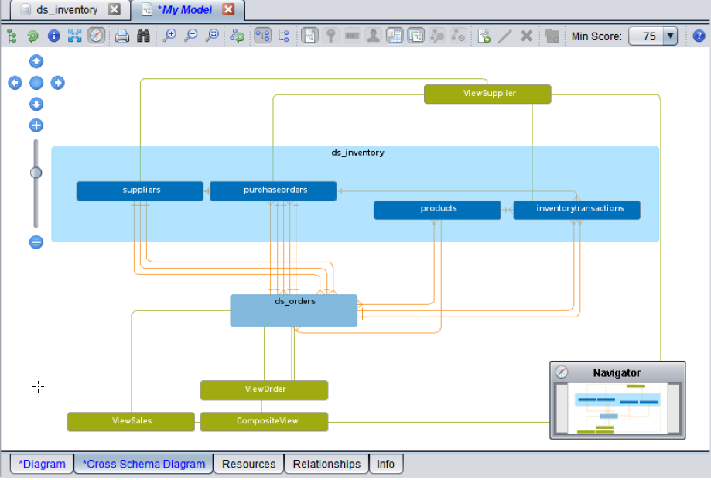
Data Abstraction Technical Design Physical Layer (DiscoveryModels)
Discovery Models
Discovery Model output folder
Discovery analyzes data sources introspected by Composite and looks for relationships with views connected one layer above the physical metadata.
Discovery shows relationships between Formatting Views and Physical Metadata.
Notes:
Discovery Models
The Composite Discovery Models provides a place to store the introspected discovery model information. Because Composite Discovery is targeted at finding relationships in the physical data, it makes sense to store the models in the Physical Layer close to where the actual physical source metadata is located.

Slide 13
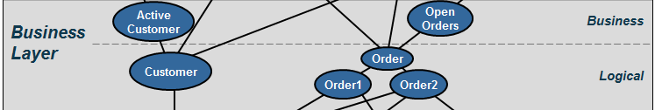

Data Abstraction Technical Design Business Layer
Business Layer
Composed of 2 sub-layers
Logical – Subject areas that are compliant with a customers logical/canonical data model. Federation of physical layer.
Business – Business rules (where clauses)
Naming Conventions for this layer
Business
Business
Logical
Notes:
Business Layer
Business layer views and services are grouped into subject areas defined by an organization’s enterprise information model. The business layer is a logical or canonical representation of the key business entities and supports federation of data across multiple data sources. Often data modeling tools such at ER/Win and ER Studio are used to create a logical data design. These models can be used as the basis for the views and data dictionary at this level. Naming of objects should reflect the logical entity and attribute names determined by data modelers. Because this layer serves to federate multiple, like views together to form a single unified result set, naming used in the underlying formatting layer should be consistent with the Business Layer.
Naming conventions are established at this layer so folder ordering within Composite is visually consistent with these diagrams.

Slide 14
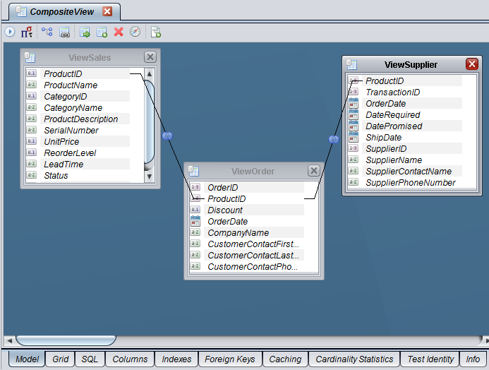
Data Abstraction Technical Design Business Layer (Logical)
Logical
Create reusable components to serve multiple consumers
Define business views, aka “data canonicals”:
Orders, Customers, etc.
Joins may occur at this level
Federated joins and unions
Pivot columns to rows
SQL-based for easy definition and maintenance
Utilization of cost-based optimizer for efficient access to data
Parallel execution
Push-down filters
Notes:
Logical
The Business Layer - Logical resources are grouped into subject areas. The Logical Views are a projection of joins, transformations or views from the Formatting Layer. This layer may serve to federate multiple, like views together to form a single unified result set. It is vital that this layer only access other logical views or formatting views and ‘never’ access the physical views. The Business Layer in general may be a combination of Views and SQL Procedures. Views do not have logic other than joins, filters or parameters. SQL Procedures provide logic and are much like stored procedures in databases. SQL Procedures can access logical views or abstract views. Create regular joins, federated joins and unions that represent subject-areas views. Typically, no where clauses are applied in this view. A possible exception to this statement is when you require the ability to view current vs. historical data in which case a where clause with a sub-query and max(timestamp_var) would be needed to get only the current data from a warehouse.
Use subject-area sub-folders to further sub-divide the folders for easier maintenance of views.

Slide 15
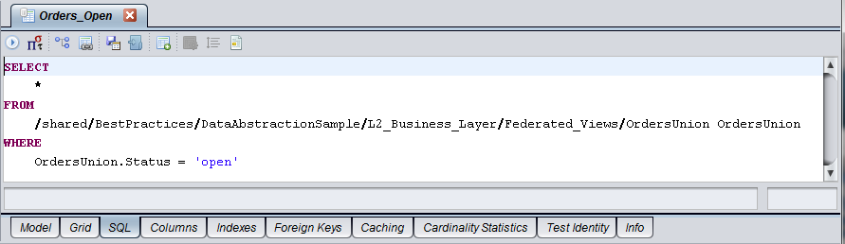
Data Abstraction Technical Design Business Layer (Business)
Business
Sub-divide into subject folders for easier maintenance of views
Business Rules (where clauses)
Subsets of data are created
Aggregation of data
Notes:
Business
The Business Layer – Business Views implement business rules by narrowing sets of data via where clauses or aggregating data. Union of data from the Logical Views is permitted when needed. These views are also grouped by subject area for improved maintenance and knowledge transfer.

Slide 16
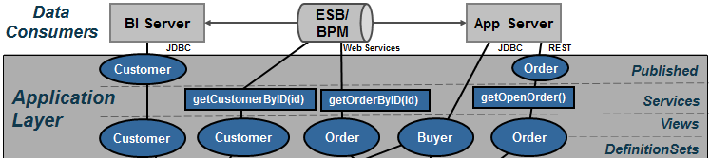

Data Abstraction Technical Design Application Layer
Application Layer
Composed of 4 sub-layers
Published – Provides a contract with the invoking applications.
Services – Provide additional procedural logic on top of views.
Views – Prepare output in the context of the client application.
Definition Sets – Contains schema, WSDL and SQL definition sets
Naming Conventions for this layer
Application
Published
Services
Views
DefinitionSets
Notes:
Application Layer
Application Layer views and procedures serve the purpose of preparing the final output into the context required by the client application. In effect, the Application Layer is the contract with the application consumer. It is recommended that views match up to client API structures (object model, XML complex types and SQL Tables). In other words, the client structure dictates the naming conventions and view contents. If XML shaping is required then Composite provides XQuery, XSLT or SQL Procedures with XML functions for shaping XML. If SQL result sets are required that are different from the logical views then a SQL Procedure can be used to provide the output as a cursor. Composite SQL Views or SQL Procedures can be published as database resources. Web Services can be published through To-Down (Contract-First) design or Bottom-Up (Generation) design.
When creating a “Top-Down” or “Contract-First” design, you start with a WSDL and map Composite resources into that WSDL. It is a best practice to establish client service procedures using XQuery with the same XML Schema as what is in the WSDL. These Composite XQuery resources are what get mapped into the WSDL. The Composite Transformation Editor can be used to map any Composite resource to the WSDL contract.
Application Layer Guidelines:
• Client API Abstraction. The Application Layer is the client API abstraction layer and names of items should reflect a view of the client API object.
• Business to Client Mapping. This layer serves as the business to client mapping and may involve a projection of joins, transformations or views from the Business layer.
• Data Manipulation. Data from the Application Layer views can be manipulated by order by’s, group by’s and aggregation but the names from the Client Views should be
retained for consistency throughout the organization.
• Narrow Results. Narrow results by selection criteria and parameterized queries
• Client. Data can be materialized (cached) intelligently at this layer to provide the best possible consumer response and throughput.
• Publish Database or Web Services. The Application Layer contains candidates for publishing as a database or Composite web service.
Naming conventions are established at this layer so folder ordering within Composite is visually consistent with these diagrams.

Slide 17
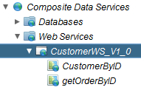
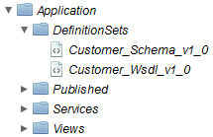
Data Abstraction Technical Design Application Layer (DefinitionSets)
Definition Sets
Web Services “contract-first” WSDLs and Schemas
Schema Definition Sets
WSDL Definition Sets
SQL Definition Sets
Notes:
Definition Sets
Application Layer – Definition Sets serve the purpose of proving the containing the web service “contract-first” WSDL and Schema definition sets
Purpose:
central place to keep schemas, WSDLs and SQL definition sets

Slide 18
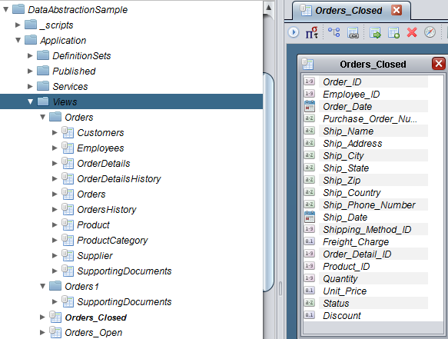
Data Abstraction Technical Design Application Layer (Views)
Views
Map business views into expected client model
Expand queries to include multiple logical or abstract components as needed to fulfill client requests
Consumed by “Published” views
Notes:
Views
Application Layer –Views serve the purpose of mapping the final output into the context required by the client application. It is recommended that views match up to client API structures (object model, XML complex types and SQL Tables). In other words, the client structure dictates the naming conventions and view contents.
Purpose:
The Application Views are the client API abstraction layer.
Names of items should reflect a business view of the API object.
Data can be materialized (cached) intelligently at this layer to provide the best possible consumer response and throughput.
This layer serves as the Business to Client Mapping and may involve a projection of joins, transformations or views from the Logical Business layer
These views are mapped to procedures which are exposed via web services or JDBC or mapped to the Application “Published” sub-layer which serves as the application contract layer.

Slide 19
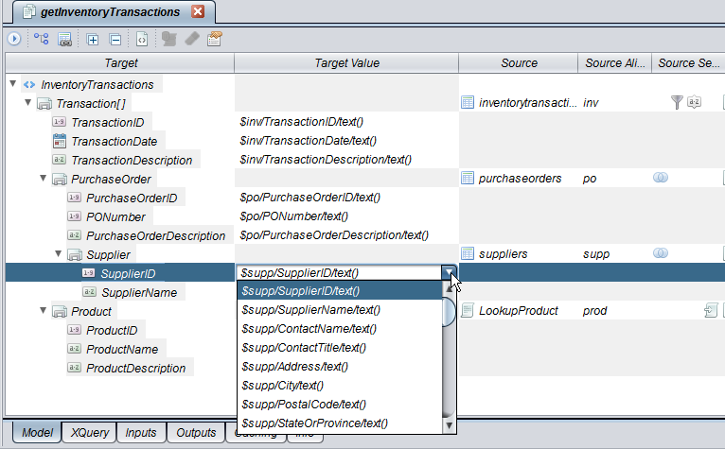
Data Abstraction Technical Design Application Layer (Services)
Services
Introduce SQL Procedures to impose governance and parameterized queries
Introduce selection criteria to narrow result sets
Introduce ordering, grouping and aggregation
Shape client views into XML documents
Publish as Web services or SQL Procedures
Notes:
Services
Application Layer – Services serve the purpose of providing additional procedural logic on top of the “Application Views” in preparation for delivering information to the client application. This might require SQL Procedures or XML-Shaping procedures if XML shaping is required. CIS provides XQuery, XSLT or SQL Procedures with XML functions for shaping XML. If SQL result sets are required that are different from the logical views then a SQL Procedure can be used to provide the output as a cursor. Any of these procedures can be published as web services. CIS SQL Views or SQL Procedures can be published as database resources. This is commonly known as bottom-up design. SQL Procedure may also be used for ordering, grouping and aggregating results. SQL Procedures may expose parameterized methods in order to conform to a governance policy by the customer.
Another option congruent to “Application Views” is the use of Designer to create a “Top-Down” or “Contract-First” design where you start with a customer WSDL and map CIS resources into that WSDL. It is a best practice to establish client service procedures using XQuery with the same XML Schema as what is in the WSDL. These CIS XQuery resources are what get mapped into the WSDL. Composite’s Transformation Editor would be used form mapping various resources to and from XML.
Purpose:
The Application Services layer contains candidates for publishing as a database or Composite web service.
Data from the Client Views can be manipulated by order by’s, group by’s and aggregation but the names from the “Application Views” should be retained for consistency throughout the organization.
Narrow results by selection criteria and parameterized queries
Shape results into XML

Slide 20
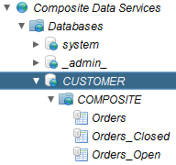
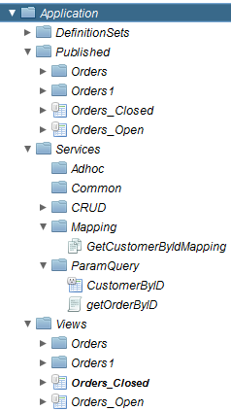
Data Abstraction Technical Design Application Layer (Published)
Published
Create a contract with the application consumer
Explicit type casting of views
Views published to Composite Databases “/services/databases/DB”
Implementation procedures published to Composite Web Services “/services/webservices/WS”
Notes:
Published
Application Layer – Published serve the purpose of proving the “contract” with the consuming application. These views are type cast and contain exactly the same name as the underlying view it was created from. There is no other logic in these views. Only type-casting should be performed in these views.
Purpose:
Provides a contract with application consumers (casting of views)
Create implementation procedures for contract-first web services.

Slide 21
Data Abstraction Scalability Composite Active Cluster
Capabilities
Active/active Clustering
Shared Cluster Cache
Replicated Metadata Repository
Advantages
Simplify your IT architecture
Reduce total cost of ownership
Composite
Information
Server
Active
Cluster
Composite
Information
Server
Composite
Information
Server
Composite
Information
Server
Notes:
Composite Active Cluster helps IT organizations improve their Data Abstraction implementations in the following ways:
High availability – High availability in Composite Active Cluster is achieved by ensuring that all CIS cluster nodes are redundant. If any one of the CIS cluster nodes fails or is removed from the cluster, the remaining nodes continue servicing the requests without requiring administrative intervention. Cluster node redundancy ensures that no data is lost and operations continue. From a client standpoint, there is no change in activity in the case of failure.
Scalability – Composite Active Cluster helps your organization scale the CIS environment on demand and based on your immediate needs. Dynamically add cluster nodes to address increased load requirements. Cluster nodes are automatically synchronized to maintain identical metadata. All cluster nodes are ‘viewed’ by clients as a single server; the clients connect to a load balancer which in turn connects the client to the next available cluster node.
Reduce RPO (Recovery Point Objective) and RTO (Recovery Time Objective) – Active Cluster ensures your RPO and RTO objectives are met. The repository can be enabled for HA/DR (High Availability/Disaster Recovery) through native or third-party capabilities (for example, Oracle RAC or VERITAS). Migration/recovery of metadata occurs automatically, minimizing impact on CIS.

Slide 22
Summary of Key Benefits
Easier to build
Onboard new data sources faster
Project teams incrementally create data virtualization layer
Easier to maintain
A place for everything, and everything in its place
Isolates changes in underlying sources
Single management console for data
Administer access to data
Monitor access to data
Secure access to data
Better performance
Optimize queries across federated sources
Notes:
SUMMARY OF KEY BENEFITS
• Easier to build. Onboard new data sources faster. Project teams can incrementally create the data abstraction layer over time and realize the reusability of existing data services.
• Easier to maintain. The Composite Information Server provides a place and categorization for everything which in turn allows you to be more effective at maintaining everything in its place.
• Single management console. The Composite Information Server provides for a single management console for access to data which includes administration, monitoring and security.
• Better performance. Composite provides better performance and scalability through query optimization, caching and clustering.

Slide 23
Practical Next Steps
Set achievable goals (without boiling the ocean)
Start with Projects and a focused team
With success, expand usage across Department and Enterprise level and broaden IT team involvement
Determine appropriate levels of abstraction
Are the four recommended layers right for you organization?
Do you need greater depth within one or more layers?
Determine modeling and mapping approach
Top down – you have a vision and you want to find the data to fulfill it
Bottom up – you know what you data looks like, now how do you make it usable by others
Start now!
Don’t over analyze
Doing will help you learn and make progress
Notes:
PRACTICAL NEXT STEPS
The main point is to get started now with a manageable project to learn from and progress.
• Set achievable goals. Start with projects and a focused team. With success, expand usage across Department and Enterprise level and broaden IT team involvement.
• Determine levels of abstraction. Are the four recommended layers right for you organization? Do you need greater depth within one or more layers? Composite Professional Services organization can help answer these questions and get you started on the right path.
• Determine modeling and mapping approach. Is it Top-down or Bottom-up?
o Top down – you have a vision and you want to find the data to fulfill it. This is often referred to as Contract-First design. In this approach Composite allows you to start with your own WSDL and map Composite services to your contract.
o Bottom up – you know what your data looks like, now how do you make it usable by others. In this approach, Composite allows you to generate or publish resources such as SQL Tables and Web Services directly from the Composite container.
• Start now! Don’t over analyze. Getting started now even if small will help you learn and make progress.

Slide 24
www.compositesw.com

Slide 25
Data Abstraction “Technical” Design Sub-Layered Architecture View
ESB/ BPM
Data Consumers
BI Server
App Server
JDBC
Web Services
JDBC
REST
Published
Application Layer
Application Layer
Services
Views
DefinitionSets
Business Layer
Business
Logical
DiscoveryModels
Physical Layer
Formatting
Metadata
Data Sources
Customers DB
Order1 DB
Order2 DB
Product
Catalog
Notes:
Sub-Layered Architecture View
The Sub-Layered Architecture View outlines four primary layers within Composite with each layer containing one to two sub-layers. At the bottom of the diagram are the data sources or information assets within an organization. At the top are various data consumers that need access to these information assets. This section will describe the purpose of each layer.
Data Consumers – client applications want to retrieve data in various formats and through different protocols. They want to receive the data in a way that they understand. Composite allows the consumers to format the data according to their specifications and deliver over various transport protocols including: Web Services, REST, JDBC and Java.
Application Layer – this layer serves to map or conform the Business layer into the format which the Data Consumer wants to see their data. It might mean formatting into XML for web services or creating views with different alias names that match the way the consumers are used to seeing their data.
Client Published – Provides the contract with the consuming application. Explicitly cast views.
Client Services – Procedural logic for shaping results, applying parameters, grouping, ordering, aggregation and XML shaping.
Client Views – client views map from the Business Layer Logical Views to the names used by the client API
Definition Sets – Provides a central location for all Schema, WSDL and SQL definition sets.
Business Layers – this layer is predicated on the idea that the business has a standard or canonical way to describing their business. In the financial industry, one often accesses information according to financial instruments and issuers amongst many other entities. Typically, a Data Modeler would work with business experts and data providers to define a set of “logical” or “canonical” views that represent the business. These views are reusable components that can and should be used across business lines by multiple consumers.
Business Views – Business Layer Views that implement business rules by narrowing sets of data via where clauses or aggregating data. Perform view unions as needed within this layer and from the logical views.
Logical Views – Business Layer Logical views predicated on the business. Perform simple joins, federated joins, unions and federated unions.
Physical Layer – the physical layer is essentially imported from the physical data sources and used as way to onboard the metadata required by the Data Virtualization layer to perform its mapping functions.
Discovery Models – The Composite Discovery Models provides a place to store the introspected discovery model information. Because Composite Discovery is targeted at finding relationships in the physical data, it makes sense to store the models in the Physical Layer close to where the actual physical source metadata is located.
Formatting Views – Formatting views perform the mapping of physical to business logical – they are the core views of the Formatting Layer. Provides a physical abstraction of the physical metadata layer for purposes of rebinding and caching. ultimately, physical data sources have to be mapped into this virtualization layer and it is the job of the formatting layer to provide simple tasks such as name aliasing, value formatting, data type casting, derived columns and light data quality mapping. In general this layer is derived from the physical sources and performs a one-to-one mapping between the physical source attributes and their corresponding “logical/canonical” attribute name. Naming conventions are very important and introduced in this layer.
Physical Metadata – Provide the metadata of the physical data sources which gives Composite a tangible entity for it’s views to point to. Entity names and attributes are never changed in this layer. It’s an as-is layer.

